Slide 1
Standardization of tumors in clinical trials database
Aditya Lahiri, Deanne Taylor

Slide 2
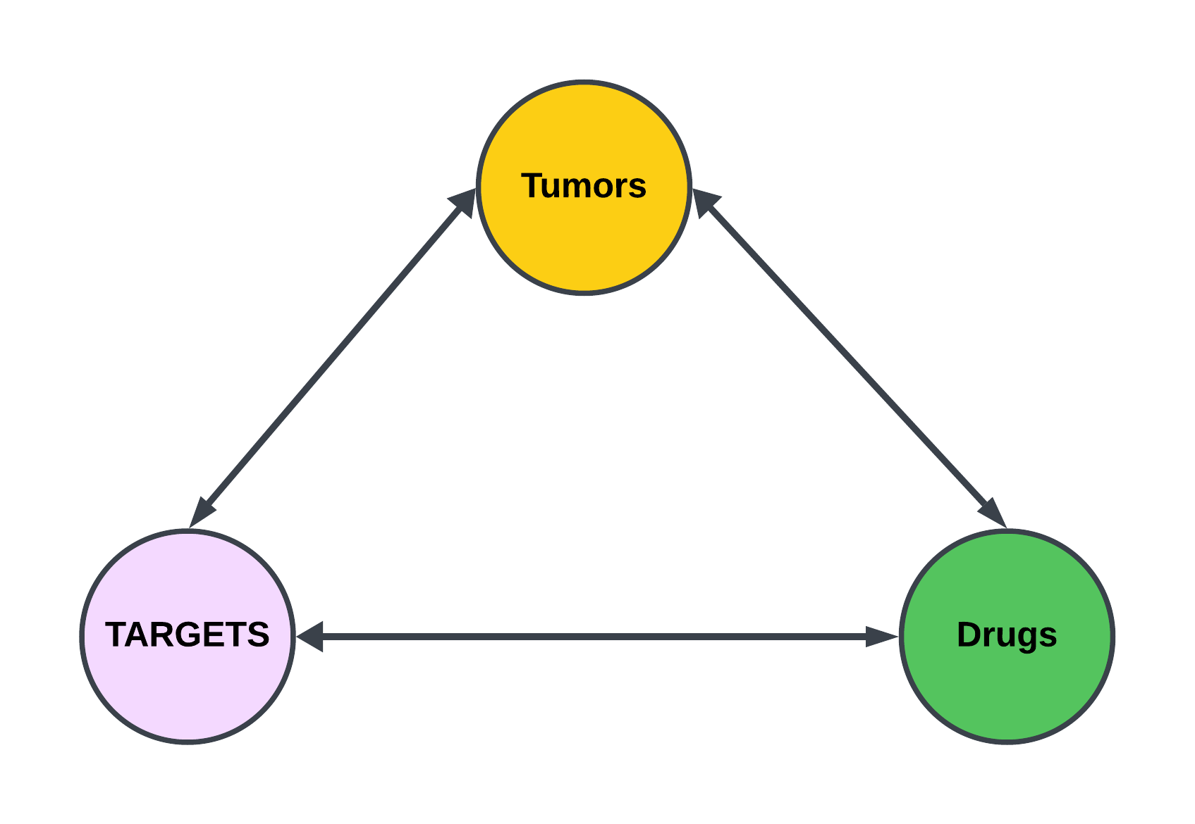
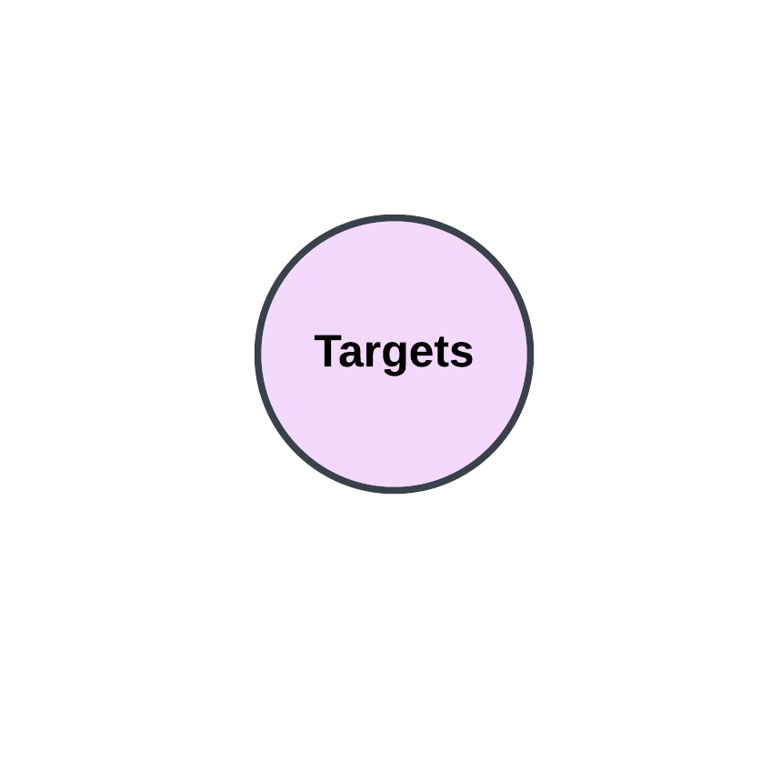
BACKGROUND

Slide 3
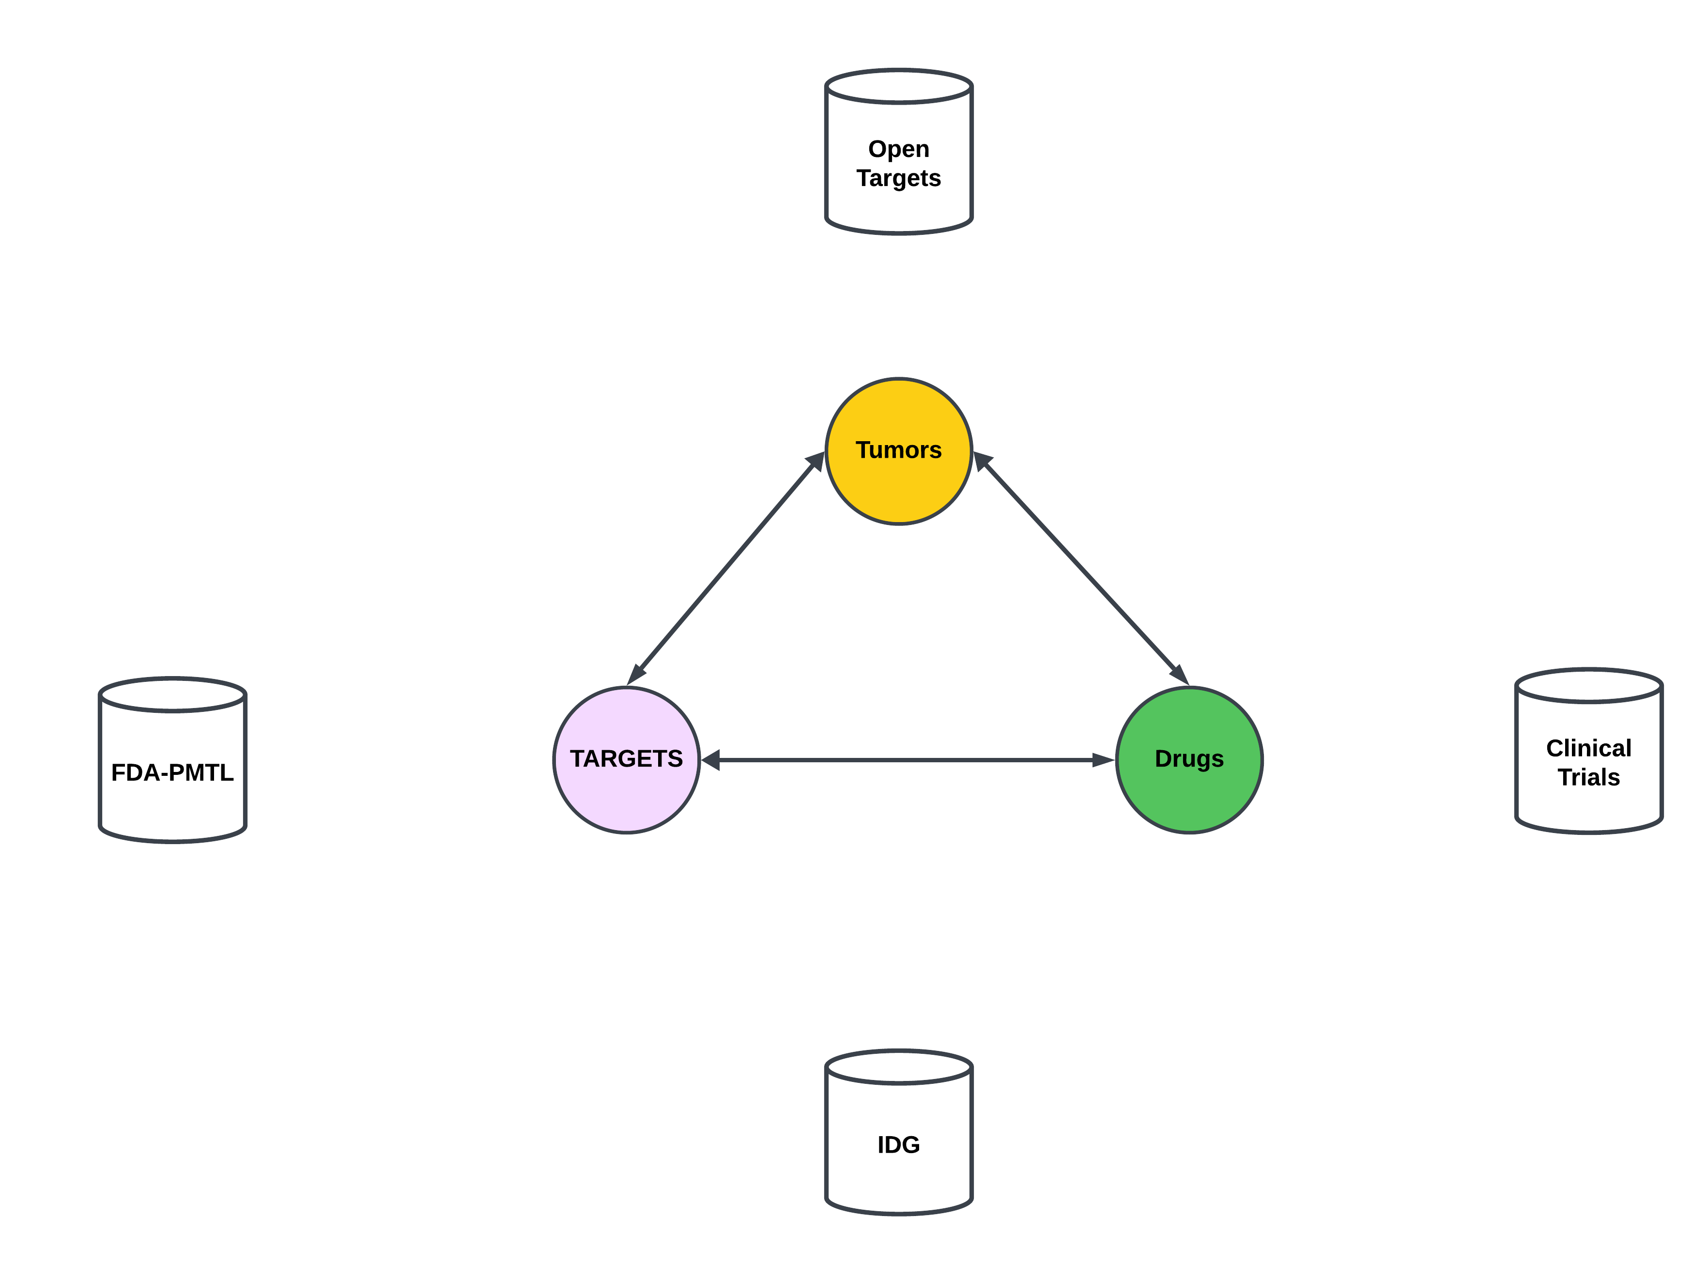
BACKGROUND
Target -Disease
Target -Drug
Drugs
Targets
Diseases
Target -Disease
Target -Drug

Slide 4
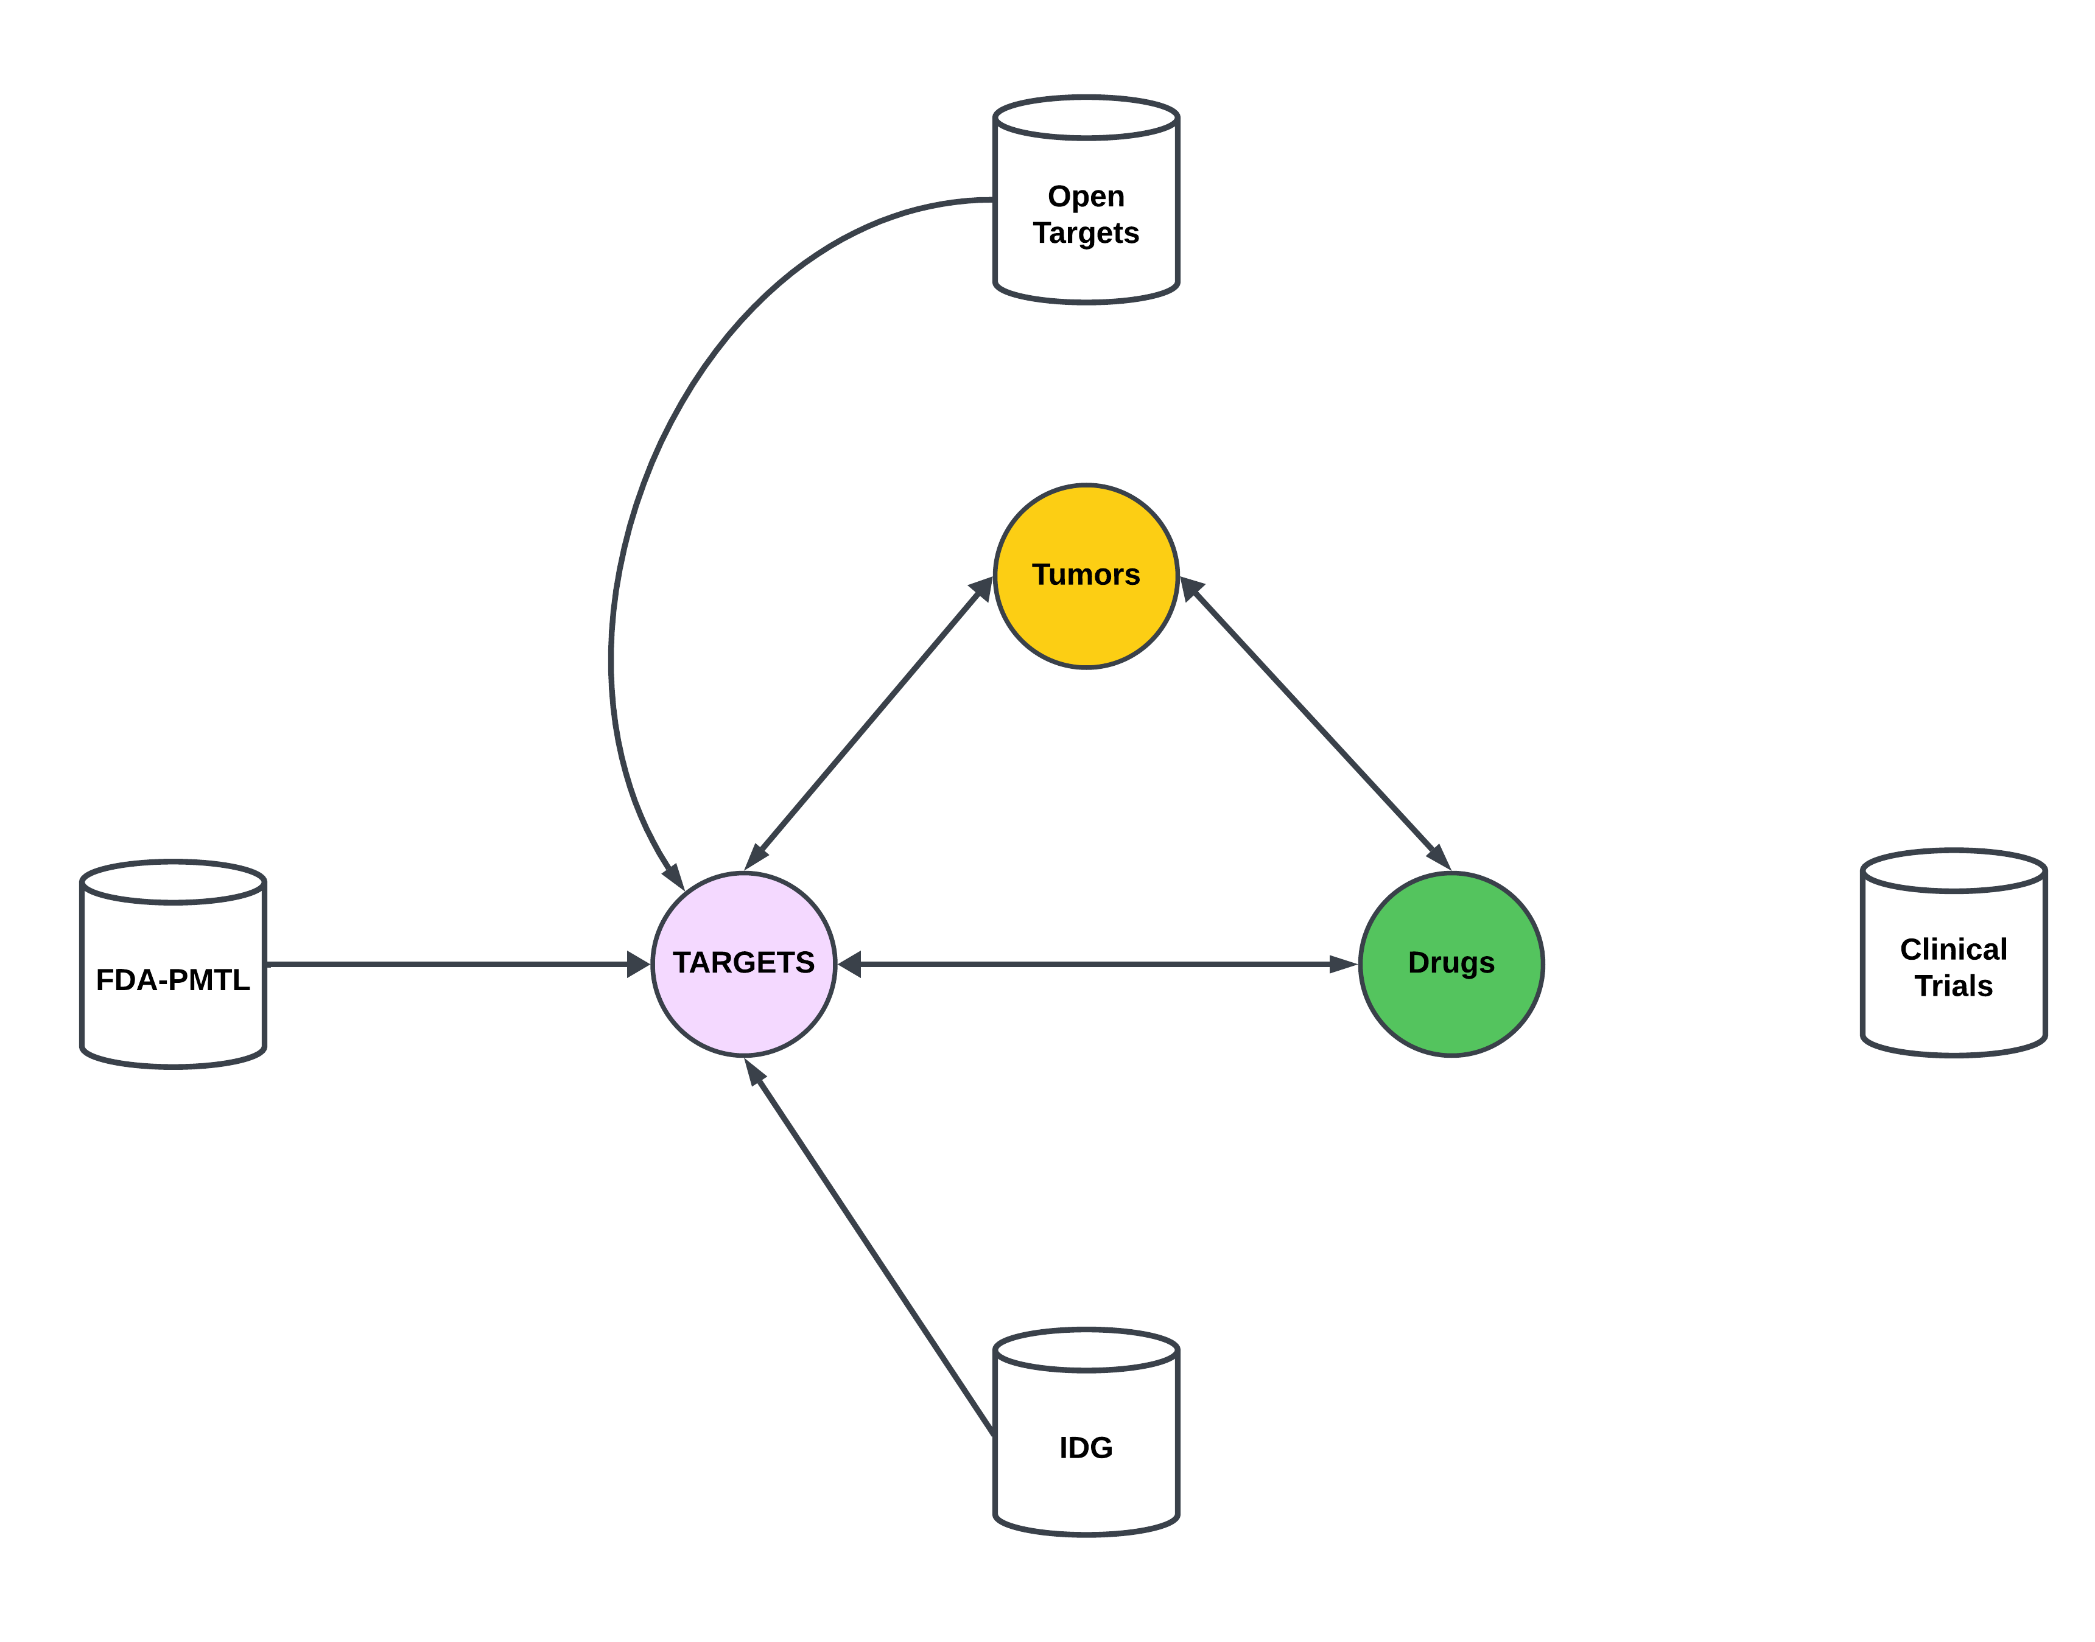
BACKGROUND
Target -Disease
Target -Drug
Drugs
Targets
Diseases
Target -Disease
Target -Drug

Slide 5
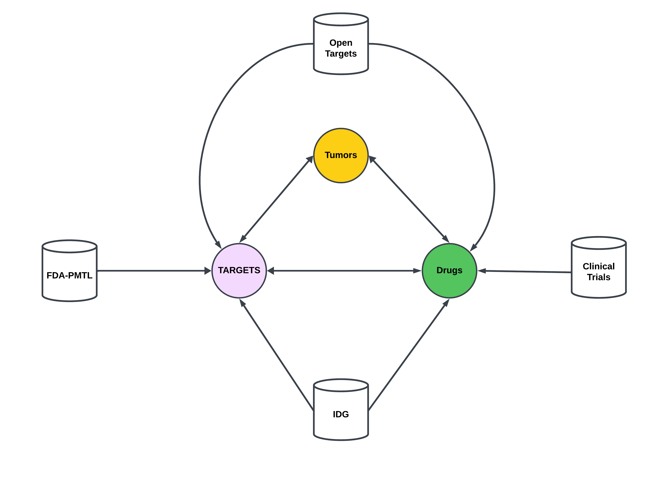
BACKGROUND
Target -Disease
Target -Drug
Drugs
Targets
Diseases
Target -Disease
Target -Drug

Slide 6
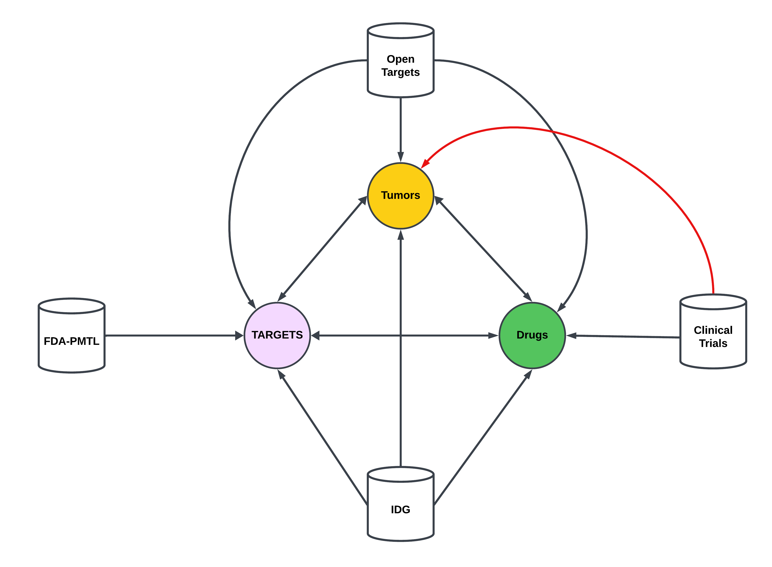
BACKGROUND
Target -Disease
Target -Drug
Drugs
Targets
Diseases
Target -Disease
Target -Drug

Slide 7
Clinical Trials: Conditions to Tumors
Tumors in clinical trials can be obtains from the “conditions” table.
Table is provided in a tab separated text file containing NCT IDs and condition names in down case.
Downloaded data on Aug 22, 2023. Data is updated monthly.
Retrieved 107,257 unique conditions/diseases.

Slide 8
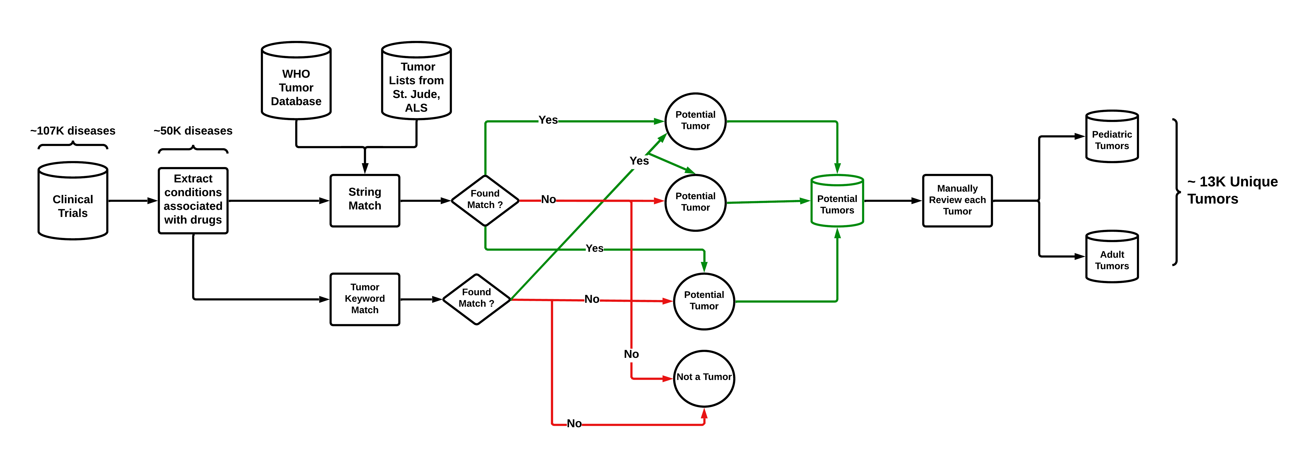
Clinical Trials: Conditions to Tumors

Slide 9
Clinical Trials: unstandardized Tumor Names
ID | NCT ID | Condition | Issues
54148559 | NCT05806385 | triple negative breast cancer | None
54158880 | NCT04529772 | diffuse large b-cell lymphoma | None
54174814 | NCT04317313 | lymphoma, large b-cell, diffuse | Comma
54159226 | NCT04139304 | ann arbor stage II diffuse large b-cell lymphoma | Staging Info provided
54160394 | NCT01365169 | stage iv colorectal cancer ajcc v7 | Staging Info provided and abbreviation added
54167219 | NCT00005799 | waldenstr√∂m macroglobulinemia | Square root typographical error
53807459 | NCT05667415 | chemotherapyÔºõadvanced gastric cancerÔºõcisplatin | Special character typographical error ,
53785094 | NCT01127841 | follicular non-hodgking¬¥s lymphoma refractory or relapsed after treatment with r-chemotherapy in first line | Special character typographical error , treatment name and details
53878247 | NCT02172768 | acute myeloid leucaemia | Name of disease spelled unconventionally.
54168238 | NCT05587556 | liver transplant, liver cancer, immunosuppressant | Disease name with other procedure and medicine
53573690 | NCT03452657 | ranibizumab | Name of drug instead of disease
53574738 | NCT04669496 | lenvatinib | Name of drug instead of disease
53756631 | NCT01227746 | asian patients with advanced gastro-intestinal stromal tumors (gist) treated with imatinib | Demographics of patient cohort, and medicine name provided.

Slide 10
Clinical Trials: Standardizing Tumor Names
Retrieved ~ 13k unique tumors form clinical trials database.
WHO tumor database (5th edition) contains 2390 standardized unique tumors.
NCIT tumor database contains 1395 standardized unique tumors.
Objective: Map unstandardized clinical trials tumors to WHO or NCIT tumors.

Slide 11
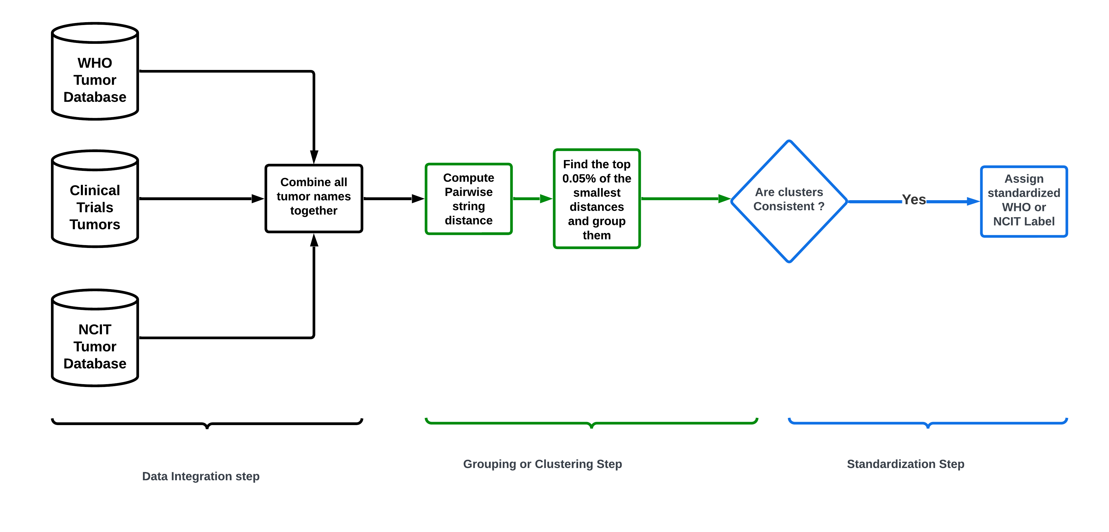
Method 1 : Edit distance

Slide 12
Method 1 : Edit distance
Distance Metrics used: 1. Levenshtein distance
2. Jarro-Winkler distance
3. Cosine distance

Slide 13
Method 1: Edit distance Benchmark Tumors
b cell lymphoma
liposarcoma
cancer of liver
smoldering myeloma
unresectable lung cancer

Slide 14
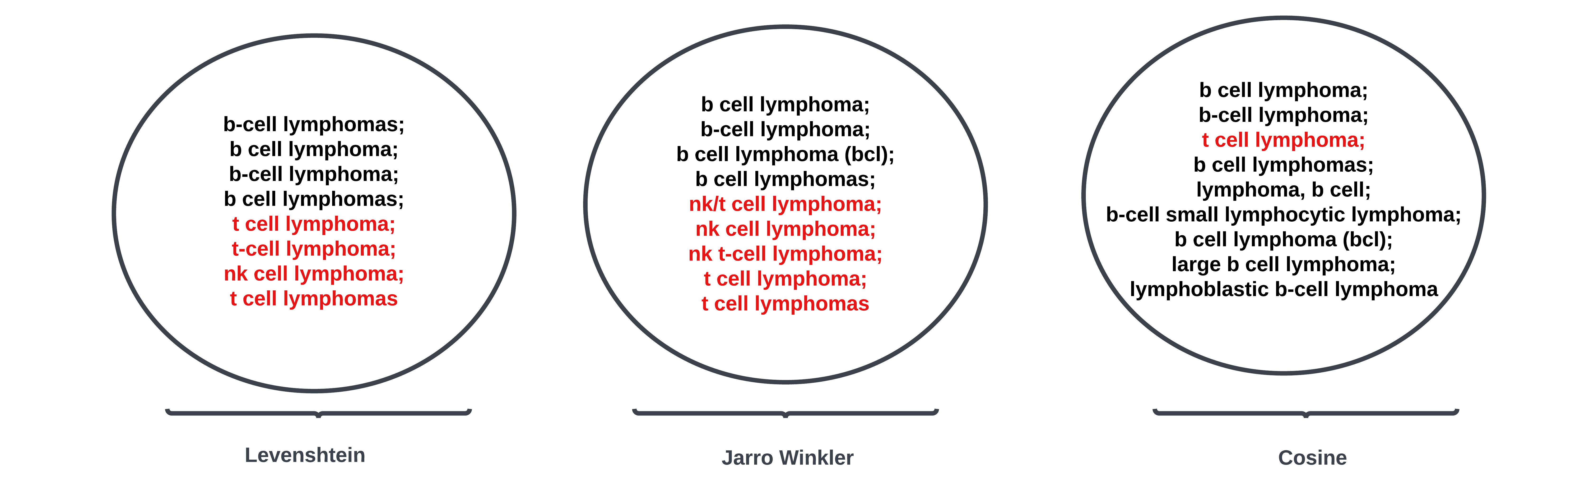
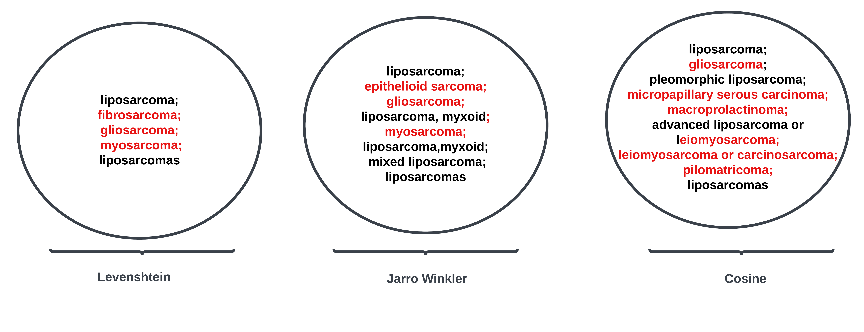
Method 1: Edit distance Benchmark Tumors
b cell lymphoma
liposarcoma

Slide 15
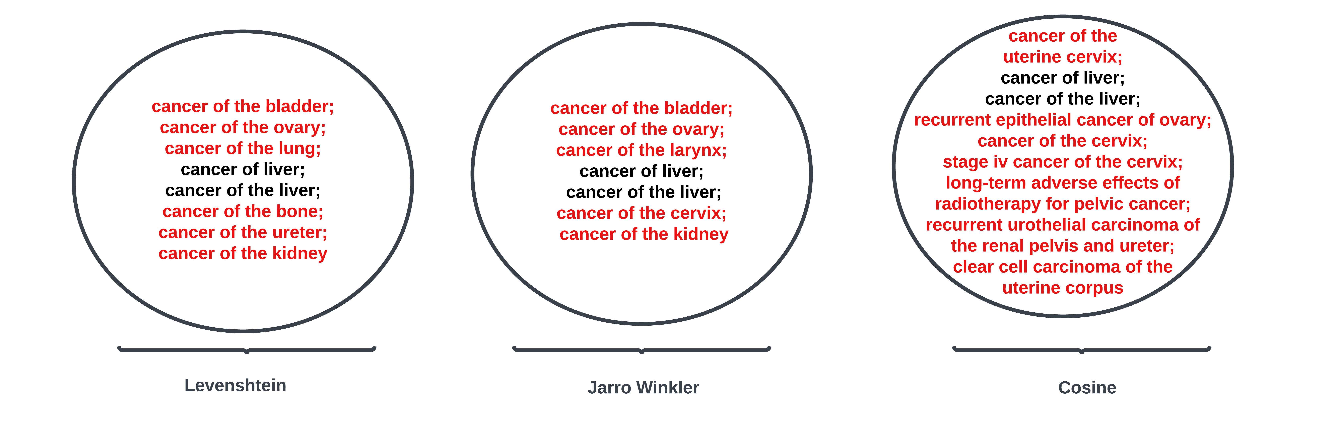
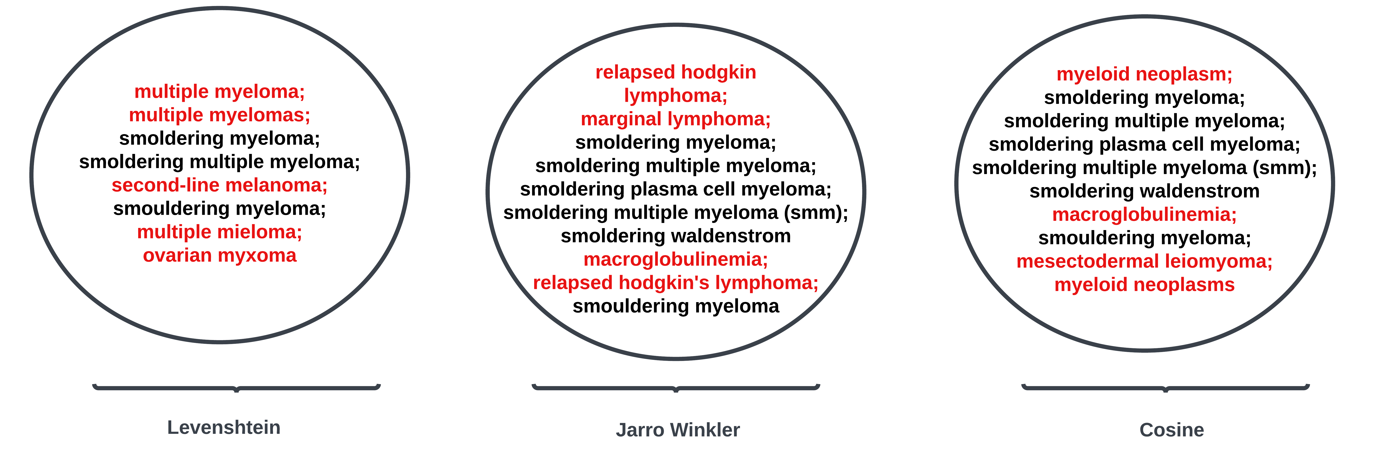
Method 1: Edit distance Benchmark Tumors
cancer of liver
smoldering myeloma

Slide 16
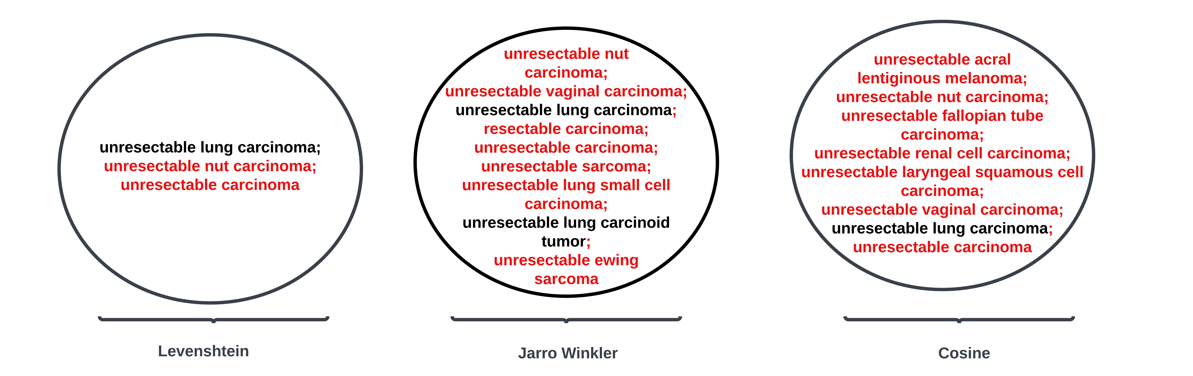
Method 1: Edit distance Benchmark Tumors
unresectable lung cancer
Key Point: Too Many False Positive Matches !!

Slide 17
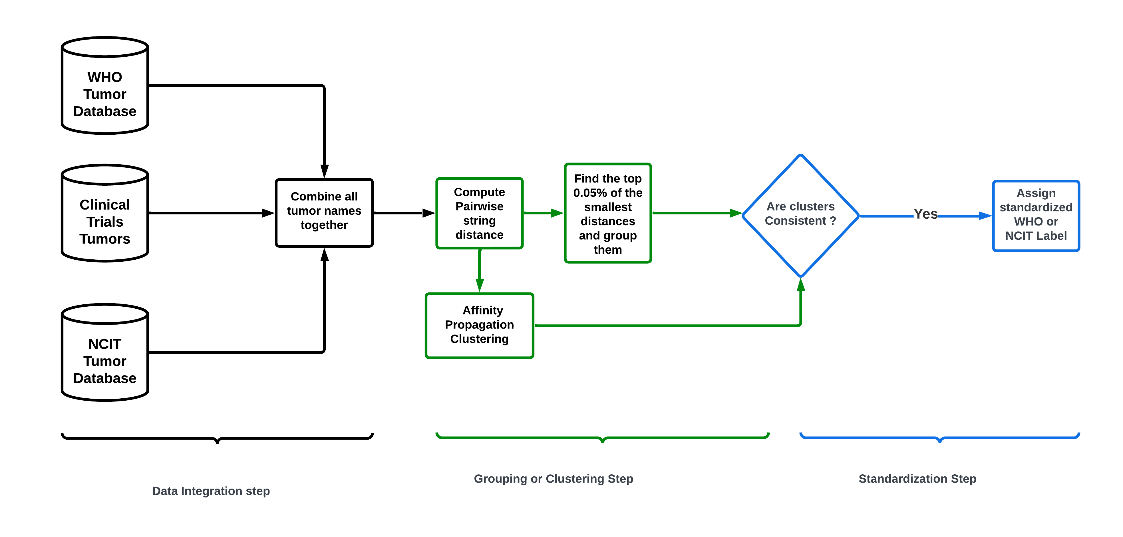
Method 2 : Edit distance + Clustering

Slide 18
Method 2 : Edit distance + Clustering
AFP+LV resulted in 7697 clusters.
AFP+JW resulted in 7148 clusters.
AFP + Cosine resulted in 6757 clusters.
Silhouette score: measure of how similar an object is to its own cluster (cohesion) compared to other clusters (separation). Silhouette score varies from -1 to 1.
A value close to 1 indicates the data point is well matched to its own cluster and poorly matched to neighboring clusters.
A low value or value close to -1 then the clustering configuration may have too many or too few clusters
Mean of silhouette score of each cluster member can be used as a consistency measure for members within a cluster.

Slide 19
Method 2 : Benchmark Results
LV + AFP | MSS | JW +AFP | MSS | Cosine + AFP | MSS
b-cell lymphomas; b cell lymphoma; b cell lymphomas; t cell lymphomas | 0.17460317 | b cell lymphoma; b cell lymphomas | 0.61032389 | b cell lymphoma; b cell lymphomas; lymphoma, b cell | 0.4127977
unresectable lung carcinoma; prostate carcinoma; unresectable melanoma; unresectable nut carcinoma ;unresectable paraganglioma; resectable carcinoma; unresectable carcinoma; resectable sarcoma; unresectable sarcoma; unresectable cancer; intraductal carcinoma | -0.1950234 | unresectable lung carcinoma; unresectable nut carcinoma; unresectable vaginal carcinoma;unresectable lung carcinoid tumor | 0.19074195 | unresectable lung carcinoma | 0
liposarcoma ;fibrosarcoma; gliosarcoma; myosarcoma; liposarcomas | 0.3225 | Liposarcoma; Gliosarcoma; Myosarcoma; liposarcoma, round cell; gliosarcoma, adult; mixed liposarcoma; liposarcomas | -0.1295667 | liposarcoma;synovial sarcoma;choroidal melanoma;myeloid sarcoma;advanced leiomyosarcoma;leiomyosarcoma of ovary;adenocarcinoma of ovary;solid alveolar rhabdomyosarcoma;rhabdomyosarcoma, pelvic;sarcoma, myeloid;localized osteosarcoma;advanced liposarcoma or leiomyosarcoma;locally advanced myxofibrosarcoma; leiomyosarcoma or carcinosarcoma;advanced or metastatic liposarcoma or leiomyosarcoma;fusion-negative alveolar rhabdomyosarcoma ;cardiac leiomyosarcoma;pleomorphic dermal sarcoma | -0.4821895
cancer of the liver; cancer of the ureter; cancer of the kidney | 0.09780815 | cancer of the liver;cancer of the ovary; cancer of the larynx;cancer of the salivary gland; cancer of the oral cavity; cancer of head; cancer, other; cancer of ovary; cancer of the pharynx; cancer of the biliary tract | -0.1121348 | cancer of the liver; cancer of cervix;cancer of the rectum;cancer of the cervix ;stage iv cancer of the cervix | -0.3244073
smoldering myeloma; smouldering myeloma | 0.88235294 | smoldering myeloma; smoldering multiple myeloma; smoldering plasma cell myeloma; smoldering multiple myeloma (smm) | -0.062071 | smoldering myeloma; smouldering myeloma | 0.78520413

Slide 20
Method 2 : Benchmark Results
LV + AFP | MSS | JW +AFP | MSS | Cosine + AFP | MSS
b-cell lymphomas; b cell lymphoma; b cell lymphomas; t cell lymphomas | 0.17460317 | b cell lymphoma; b cell lymphomas | 0.61032389 | b cell lymphoma; b cell lymphomas; lymphoma, b cell | 0.4127977
unresectable lung carcinoma; prostate carcinoma; unresectable melanoma; unresectable nut carcinoma ;unresectable paraganglioma; resectable carcinoma; unresectable carcinoma; resectable sarcoma; unresectable sarcoma; unresectable cancer; intraductal carcinoma | -0.1950234 | unresectable lung carcinoma; unresectable nut carcinoma; unresectable vaginal carcinoma;unresectable lung carcinoid tumor | 0.19074195 | unresectable lung carcinoma | 0
liposarcoma ;fibrosarcoma; gliosarcoma; myosarcoma; liposarcomas | 0.3225 | Liposarcoma; Gliosarcoma; Myosarcoma; liposarcoma, round cell; gliosarcoma, adult; mixed liposarcoma; liposarcomas | -0.1295667 | liposarcoma;synovial sarcoma;choroidal melanoma;myeloid sarcoma;advanced leiomyosarcoma;leiomyosarcoma of ovary;adenocarcinoma of ovary;solid alveolar rhabdomyosarcoma;rhabdomyosarcoma, pelvic;sarcoma, myeloid;localized osteosarcoma;advanced liposarcoma or leiomyosarcoma;locally advanced myxofibrosarcoma; leiomyosarcoma or carcinosarcoma;advanced or metastatic liposarcoma or leiomyosarcoma;fusion-negative alveolar rhabdomyosarcoma ;cardiac leiomyosarcoma;pleomorphic dermal sarcoma | -0.4821895
cancer of the liver; cancer of the ureter; cancer of the kidney | 0.09780815 | cancer of the liver;cancer of the ovary; cancer of the larynx;cancer of the salivary gland; cancer of the oral cavity; cancer of head; cancer, other; cancer of ovary; cancer of the pharynx; cancer of the biliary tract | -0.1121348 | cancer of the liver; cancer of cervix;cancer of the rectum;cancer of the cervix ;stage iv cancer of the cervix | -0.3244073
smoldering myeloma; smouldering myeloma | 0.88235294 | smoldering myeloma; smoldering multiple myeloma; smoldering plasma cell myeloma; smoldering multiple myeloma (smm) | -0.062071 | smoldering myeloma; smouldering myeloma | 0.78520413
Key point: Edit distance + clustering still results in inconsistent grouping of tumors.

Slide 21
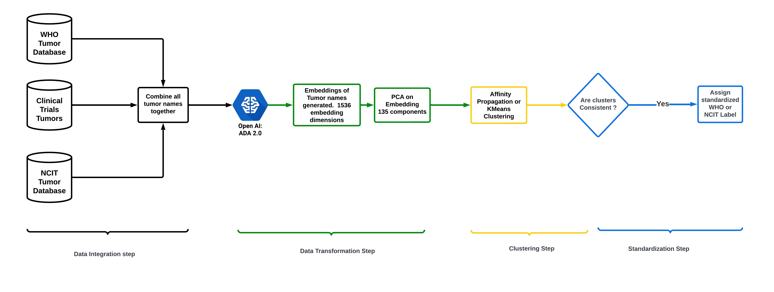
Method 3 : Embedding + Clustering

Slide 22
Method 3 : Embedding + Clustering
Embeddings are low level, numeric representations of words or sentences. Words or sentences with similar meaning will have similar embedding.
Open AI’s ADA 2.0 generates word embeddings that have 1536 dimensions.
Embeddings are normalized to length 1.
Cost of generating embeddings for all tumors ~$6.00

Slide 23
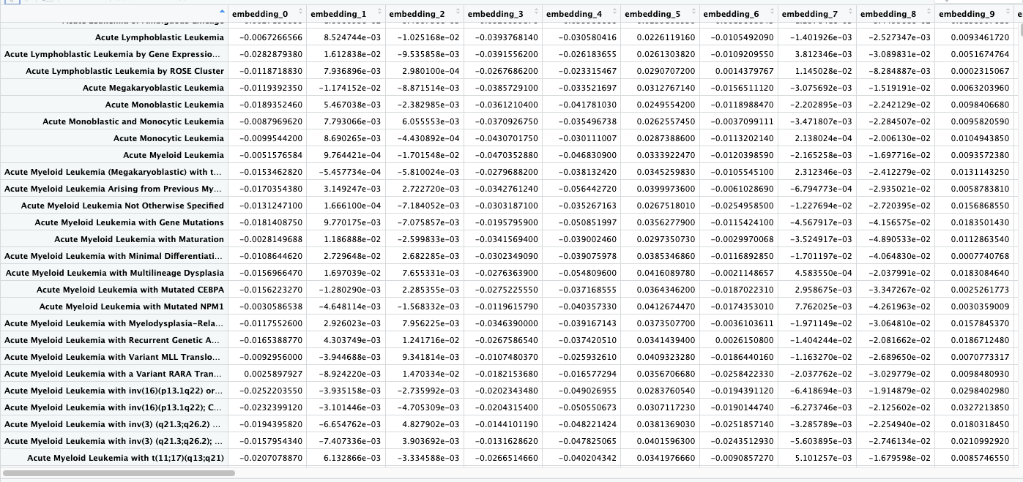
Method 3 : Embedding + Clustering

Slide 24
Method 3 : Embedding + Clustering

Slide 25
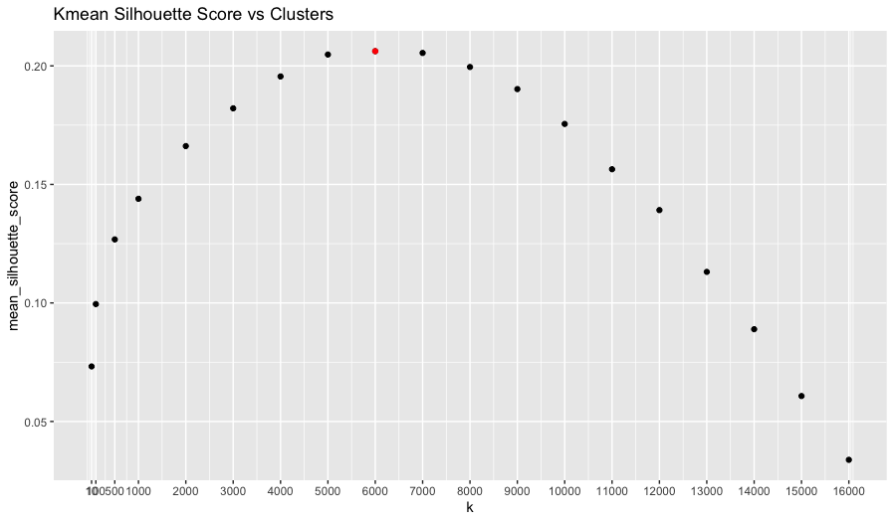
Method 3 : Embedding + Clustering
Affinity Propagation clustering in resulted in 1113 clusters.
Kmeans clustering resulted in 6000 clusters. Euclidean distance was used as dissimilarity metric.

Slide 26
Method 3 : Benchmark Results
AFP Clusters | MSS | Kmeans (K=6000) | MSS
b cell lymphoma; b cell lymphoma (bcl); b cell lymphomas; b lineage lymphoblastic lymphoma; b-cell all; b-cell lymphoid cancer; b-cell lymphoma; b-cell lymphomas; b-cell lymphomas (phase 1); b-cell malignancy; b-cell neoplasm; b-cell small lymphocytic lymphoma; monoclonal b-cell lymphocytosis; other subtypes of b-cell lymphoma | -0.0162202 | b cell lymphoma;b cell lymphoma (bcl) ;b cell lymphomas;b-cell lymphoid cancer;b-cell lymphoma;b-cell lymphomas | 0.23489899
adult liposarcoma;childhood liposarcoma;liposarcoma; liposarcoma of the thorax;liposarcoma, round cell; liposarcoma; mixed type;liposarcomas; mixed liposarcoma;pleomorphic liposarcoma; virally mediated cancers and liposarcoma | -0.0223193 | Liposarcoma ;adult liposarcoma; liposarcomas | 0.1441252
unresectable lung carcinoma; unresectable lung non-small cell carcinoma;unresectable lung non-squamous non-small cell carcinoma;unresectable lung small cell carcinoma;unresectable non-small cell lung cancer (nsclc) and urothelial cancer;unresectable non-small cell lung carcinoma;unresectable stage iii non-small cell lung cancer | 0.26030134 | unresectable lung carcinoma; unresectable lung small cell carcinoma | 0.05125004
cancer of the liver; cancer of liver; liver cancer | 0.42995898 | cancer of liver; cancer of the liver; liver cancer | 0.38949709
smoldering myeloma; smoldering multiple myeloma; smoldering multiple myeloma (smm); smoldering plasma cell myeloma; smouldering myeloma | 0.272505 | smoldering myeloma;smoldering multiple myeloma;smoldering multiple myeloma (smm); smouldering myeloma; high risk smoldering multiple myeloma; high-risk smoldering multiple myeloma | 0.25361543

Slide 27
Method 3 : Benchmark Results
AFP Clusters | MSS | Kmeans (K=6000) | MSS
b cell lymphoma; b cell lymphoma (bcl); b cell lymphomas; b lineage lymphoblastic lymphoma; b-cell all; b-cell lymphoid cancer; b-cell lymphoma; b-cell lymphomas; b-cell lymphomas (phase 1); b-cell malignancy; b-cell neoplasm; b-cell small lymphocytic lymphoma; monoclonal b-cell lymphocytosis; other subtypes of b-cell lymphoma | -0.0162202 | b cell lymphoma;b cell lymphoma (bcl) ;b cell lymphomas;b-cell lymphoid cancer;b-cell lymphoma;b-cell lymphomas | 0.23489899
adult liposarcoma;childhood liposarcoma;liposarcoma; liposarcoma of the thorax;liposarcoma, round cell; liposarcoma; mixed type;liposarcomas; mixed liposarcoma;pleomorphic liposarcoma; virally mediated cancers and liposarcoma | -0.0223193 | Liposarcoma ;adult liposarcoma; liposarcomas | 0.1441252
unresectable lung carcinoma; unresectable lung non-small cell carcinoma;unresectable lung non-squamous non-small cell carcinoma;unresectable lung small cell carcinoma;unresectable non-small cell lung cancer (nsclc) and urothelial cancer;unresectable non-small cell lung carcinoma;unresectable stage iii non-small cell lung cancer | 0.26030134 | unresectable lung carcinoma; unresectable lung small cell carcinoma | 0.05125004
cancer of the liver; cancer of liver; liver cancer | 0.42995898 | cancer of liver; cancer of the liver; liver cancer | 0.38949709
smoldering myeloma; smoldering multiple myeloma; smoldering multiple myeloma (smm); smoldering plasma cell myeloma; smouldering myeloma | 0.272505 | smoldering myeloma;smoldering multiple myeloma;smoldering multiple myeloma (smm); smouldering myeloma; high risk smoldering multiple myeloma; high-risk smoldering multiple myeloma | 0.25361543
Key point: more consistent clusters compared to the methods involving edit distances.

Slide 28
Method 3 : Benchmark Results
AFP Clusters | MSS | Kmeans (K=6000) | MSS
b cell lymphoma; b cell lymphoma (bcl); b cell lymphomas; b lineage lymphoblastic lymphoma; b-cell all; b-cell lymphoid cancer; b-cell lymphoma; b-cell lymphomas; b-cell lymphomas (phase 1); b-cell malignancy; b-cell neoplasm; b-cell small lymphocytic lymphoma; monoclonal b-cell lymphocytosis; other subtypes of b-cell lymphoma | -0.0162202 | b cell lymphoma;b cell lymphoma (bcl) ;b cell lymphomas;b-cell lymphoid cancer;b-cell lymphoma;b-cell lymphomas | 0.23489899
adult liposarcoma;childhood liposarcoma;liposarcoma; liposarcoma of the thorax;liposarcoma, round cell; liposarcoma; mixed type;liposarcomas; mixed liposarcoma;pleomorphic liposarcoma; virally mediated cancers and liposarcoma | -0.0223193 | Liposarcoma ;adult liposarcoma; liposarcomas | 0.1441252
unresectable lung carcinoma; unresectable lung non-small cell carcinoma;unresectable lung non-squamous non-small cell carcinoma;unresectable lung small cell carcinoma;unresectable non-small cell lung cancer (nsclc) and urothelial cancer;unresectable non-small cell lung carcinoma;unresectable stage iii non-small cell lung cancer | 0.26030134 | unresectable lung carcinoma; unresectable lung small cell carcinoma | 0.05125004
cancer of the liver; cancer of liver; liver cancer | 0.42995898 | cancer of liver; cancer of the liver; liver cancer | 0.38949709
smoldering myeloma; smoldering multiple myeloma; smoldering multiple myeloma (smm); smoldering plasma cell myeloma; smouldering myeloma | 0.272505 | smoldering myeloma;smoldering multiple myeloma;smoldering multiple myeloma (smm); smouldering myeloma; high risk smoldering multiple myeloma; high-risk smoldering multiple myeloma | 0.25361543
Key point: more consistent clusters compared to the methods involving edit distances.
Key point: AF cluster can detect string variations and group them together.

Slide 29
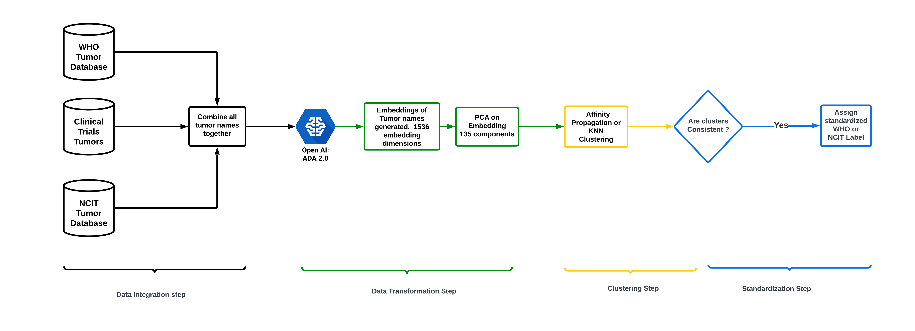
Standardization Method 3 : Standardization Step

Slide 30
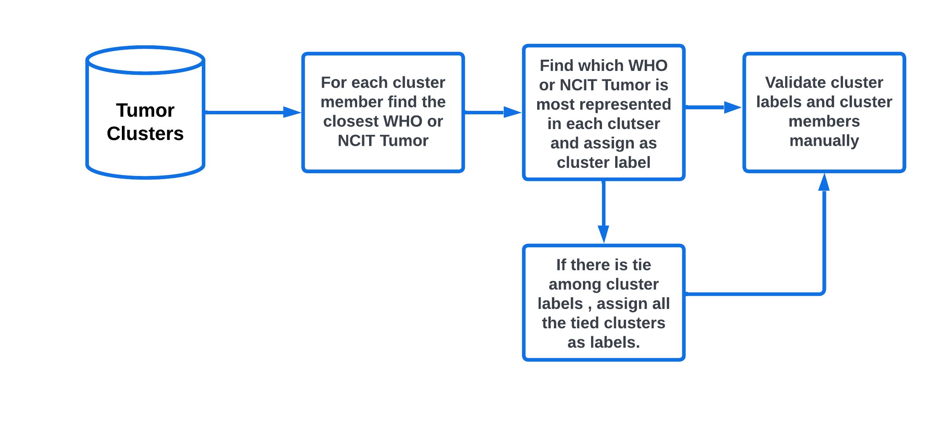
Standardization Method 3 : Standardization Step

Slide 31
Standardization Method 3 : Standardization Step BENCHMARK Tumors
AFP Clusters | MSS | Cluster Label
b cell lymphoma; b cell lymphoma (bcl); b cell lymphomas; b lineage lymphoblastic lymphoma; b-cell all; b-cell lymphoid cancer; b-cell lymphoma; b-cell lymphomas; b-cell lymphomas (phase 1); b-cell malignancy; b-cell neoplasm; b-cell small lymphocytic lymphoma; monoclonal b-cell lymphocytosis; other subtypes of b-cell lymphoma | -0.0162202 | b-cell lymphomas
adult liposarcoma;childhood liposarcoma;liposarcoma; liposarcoma of the thorax;liposarcoma, round cell; liposarcoma; mixed type;liposarcomas; mixed liposarcoma;pleomorphic liposarcoma; virally mediated cancers and liposarcoma | -0.0223193 | liposarcoma
unresectable lung carcinoma; unresectable lung non-small cell carcinoma;unresectable lung non-squamous non-small cell carcinoma;unresectable lung small cell carcinoma;unresectable non-small cell lung cancer (nsclc) and urothelial cancer;unresectable non-small cell lung carcinoma;unresectable stage iii non-small cell lung cancer | 0.26030134 | non-small cell lung carcinoma
cancer of the liver; cancer of liver; liver cancer | 0.42995898 | liver tumours
smoldering myeloma; smoldering multiple myeloma; smoldering multiple myeloma (smm); smoldering plasma cell myeloma; smouldering myeloma | 0.272505 | smoldering plasma cell myeloma

Slide 32
Standardization Method 3 : Standardization Step Hematological Tumors
AFP Clusters | Cluster Label
adult acute eosinophilic leukemia; adult acute lymphoblastic leukemia; adult acute lymphocytic leukemia; adult acute lymphocytic leukemia t-cell; adult acute lymphoid leukemia | acute lymphoblastic leukemia
acute myeloid leukemia (megakaryoblastic) with t(1;22)(p13.3;q13.3); rbm15-mkl1 acute myeloid leukemia with t(11;17)(q13;q21) acute myeloid leukemia with t(11;17)(q23;q21) acute myeloid leukemia with t(17;17)(q21;q21) acute myeloid leukemia with t(5;17)(q35;q21) acute myeloid leukemia with t(6;9) (p23;q34.1); dek-nup214; acute myeloid leukemia with t(7;12)(q36;p13); hlxb9-etv6 | acute myeloid leukemia (megakaryoblastic) with t(1;22)(p13.3;q13.3); rbm15-mkl1; acute myeloid leukemia with t(11;17)(q13;q21); acute myeloid leukemia with t(11;17)(q23;q21); acute myeloid leukemia with t(17;17)(q21;q21); acute myeloid leukemia with t(5;17)(q35;q21); acute myeloid leukemia with t(6;9) (p23;q34.1); dek-nup214; acute myeloid leukemia with t(7;12)(q36;p13); hlxb9-etv6
adult b lymphoblastic lymphoma; adult immunoblastic large cell lymphoma; adult lymphoblastic lymphoma; adult lymphoma; adult t lymphoblastic lymphoma | adult t cell leukaemia/lymphoma
aggressive lymphoma agressive lymphoma high-risk aggressive lymphoma after auto-hsct | aggressive nk-cell leukaemia

Slide 33
Next steps
Generated embeddings using V3 Large (3072 dimensions). Better embeddings will likely lead to more consistent clusters.
Implement outlier detection inside cluster, using methods such as isolation forests or local outlier factors. This will allow us to identify clusters that need to be made sparser.
Explore possibilities to tune clustering algorithms based on different tumor classes (e.g., hematological tumors, CNS tumors).
Validate cluster memberships and labels manually.

Slide 34
Acknowledgements
Dr. Elizabeth Margolskee, Hematology Laboratory
Dr. Sangeeta Shukla, DBHI
Dr. Deanne Taylor , DBHI

Slide 35
End

Slide 36
Method 1: Edit distance Benchmark Results
Tumors | Levenshtein | Jarro Winkler | Cosine
b cell lymphoma | b-cell lymphomas;b cell lymphoma;b-cell lymphoma;t cell lymphoma;b cell lymphomas;t-cell lymphoma;nk cell lymphoma;t cell lymphomas | b cell lymphoma;b-cell lymphoma;t cell lymphoma;b cell lymphomas;nk/t cell lymphoma;nk cell lymphoma;nk t-cell lymphoma;b cell lymphoma (bcl);t cell lymphomas | b cell lymphoma;b-cell lymphoma;t cell lymphoma;b cell lymphomas;lymphoma, b cell;b-cell small lymphocytic lymphoma;b cell lymphoma (bcl);large b cell lymphoma;lymphoblastic b-cell lymphoma
unresectable lung carcinoma | unresectable nut carcinoma;unresectable lung carcinoma;unresectable carcinoma | unresectable nut carcinoma;unresectable vaginal carcinoma;unresectable lung carcinoma;resectable carcinoma;unresectable carcinoma;unresectable sarcoma;unresectable lung small cell carcinoma;unresectable lung carcinoid tumor;unresectable ewing sarcoma | unresectable acral lentiginous melanoma;unresectable nut carcinoma;unresectable fallopian tube carcinoma;unresectable renal cell carcinoma;unresectable laryngeal squamous cell carcinoma;unresectable vaginal carcinoma;unresectable lung carcinoma;unresectable carcinoma
liposarcoma | liposarcoma;fibrosarcoma;gliosarcoma; myosarcoma;liposarcomas | liposarcoma;epithelioid sarcoma;gliosarcoma;liposarcoma, myxoid;myosarcoma;liposarcoma,myxoid; mixed liposarcoma;liposarcomas | liposarcoma;gliosarcoma;pleomorphic liposarcoma;micropapillary serous carcinoma;macroprolactinoma;advanced liposarcoma or leiomyosarcoma;leiomyosarcoma or carcinosarcoma;pilomatricoma;liposarcomas
cancer of the liver | cancer of the bladder;cancer of the ovary;cancer of the lung;cancer of liver;cancer of the liver;cancer of the bone;cancer of the ureter;cancer of the kidney | cancer of the bladder;cancer of the ovary;cancer of the larynx;cancer of liver; cancer of the liver;cancer of the cervix; cancer of the kidney | cancer of the uterine cervix;cancer of liver;cancer of the liver;recurrent epithelial cancer of ovary;cancer of the cervix;stage iv cancer of the cervix;long-term adverse effects of radiotherapy for pelvic cancer;recurrent urothelial carcinoma of the renal pelvis and ureter;clear cell carcinoma of the uterine corpus
smoldering myeloma | multiple myeloma;multiple myelomas;smoldering myeloma;smoldering multiple myeloma;second-line melanoma;smouldering myeloma;multiple mieloma;ovarian myxoma | relapsed hodgkin lymphoma;marginal lymphoma;smoldering myeloma;smoldering multiple myeloma;smoldering plasma cell myeloma;smoldering multiple myeloma (smm);smoldering waldenstrom macroglobulinemia;relapsed hodgkin's lymphoma;smouldering myeloma | myeloid neoplasm;smoldering myeloma;smoldering multiple myeloma;smoldering plasma cell myeloma;smoldering multiple myeloma (smm);smoldering waldenstrom macroglobulinemia;smouldering myeloma;mesectodermal leiomyoma;myeloid neoplasms

Slide 37
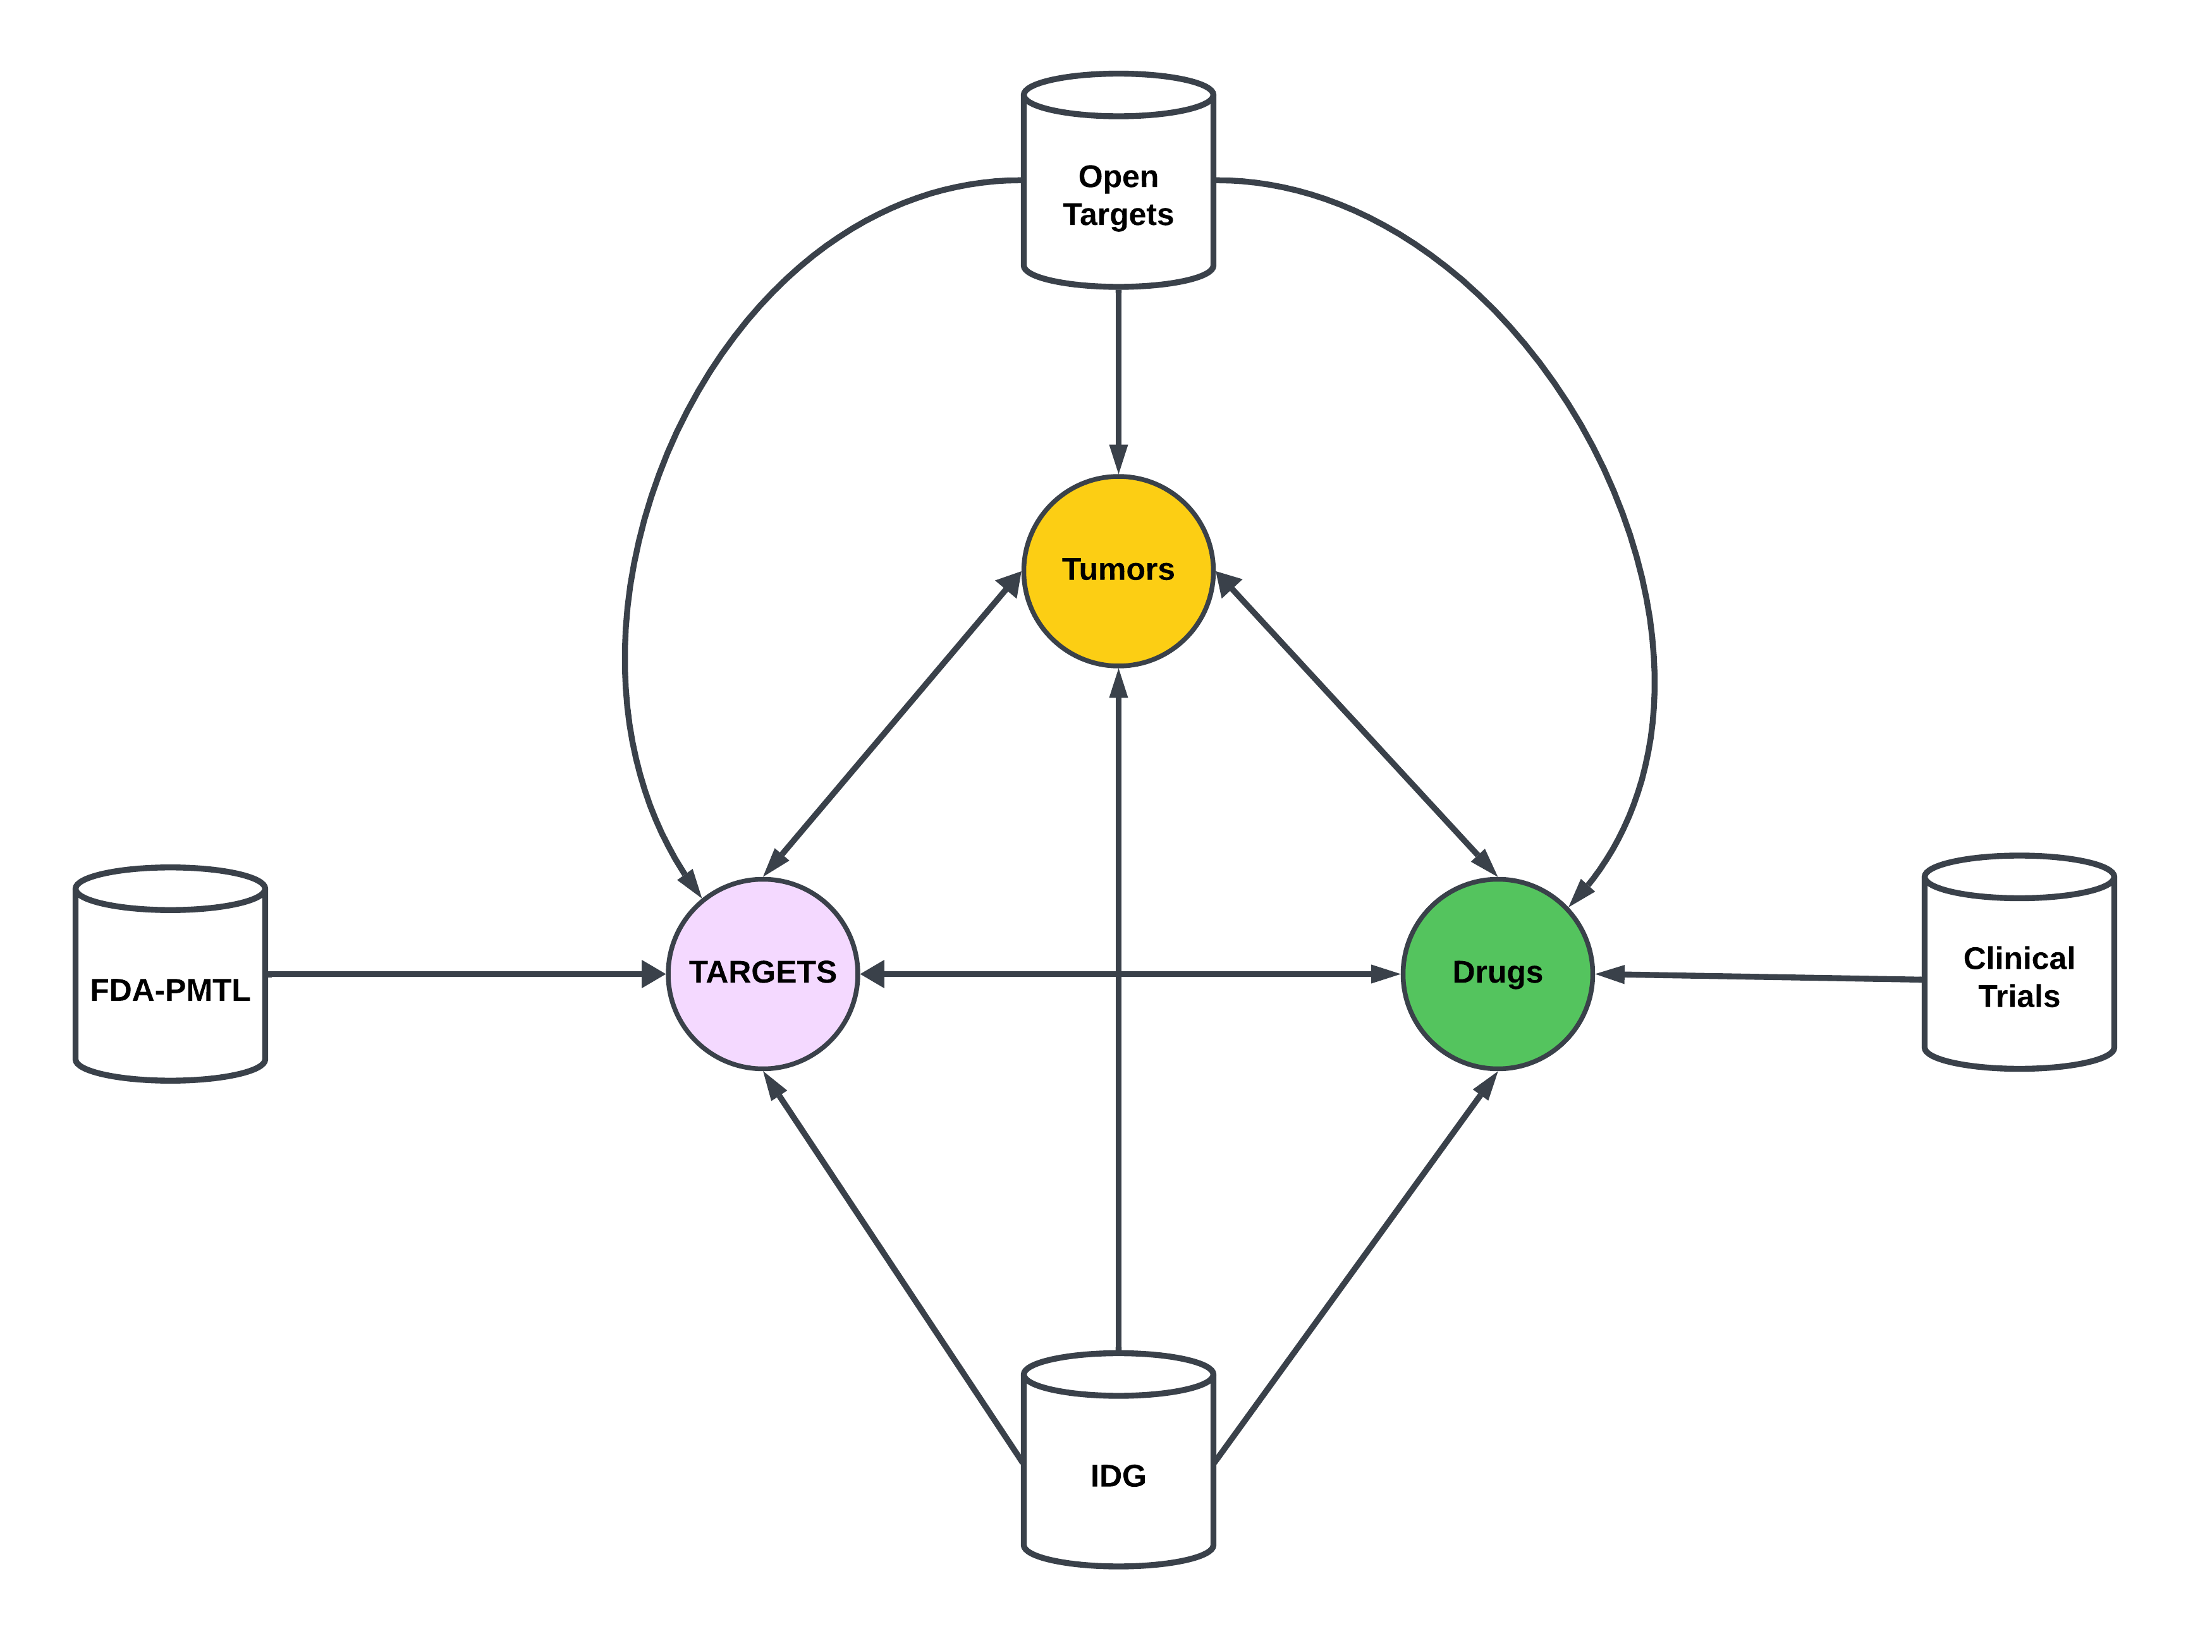
BACKGROUND

Slide 38
Method 1 : Benchmark Results
Tumors | Levenshtein | Jarro Winkler | Cosine
b cell lymphoma | b-cell lymphomas;b cell lymphoma;b-cell lymphoma;t cell lymphoma;b cell lymphomas;t-cell lymphoma;nk cell lymphoma;t cell lymphomas | b cell lymphoma;b-cell lymphoma;t cell lymphoma;b cell lymphomas;nk/t cell lymphoma;nk cell lymphoma;nk t-cell lymphoma;b cell lymphoma (bcl);t cell lymphomas | b cell lymphoma;b-cell lymphoma;t cell lymphoma;b cell lymphomas;lymphoma, b cell;b-cell small lymphocytic lymphoma;b cell lymphoma (bcl);large b cell lymphoma;lymphoblastic b-cell lymphoma
unresectable lung carcinoma | unresectable nut carcinoma;unresectable lung carcinoma;unresectable carcinoma | unresectable nut carcinoma;unresectable vaginal carcinoma;unresectable lung carcinoma;resectable carcinoma;unresectable carcinoma;unresectable sarcoma;unresectable lung small cell carcinoma;unresectable lung carcinoid tumor;unresectable ewing sarcoma | unresectable acral lentiginous melanoma;unresectable nut carcinoma;unresectable fallopian tube carcinoma;unresectable renal cell carcinoma;unresectable laryngeal squamous cell carcinoma;unresectable vaginal carcinoma;unresectable lung carcinoma;unresectable carcinoma
liposarcoma | liposarcoma;fibrosarcoma;gliosarcoma; myosarcoma;liposarcomas | liposarcoma;epithelioid sarcoma;gliosarcoma;liposarcoma, myxoid;myosarcoma;liposarcoma,myxoid; mixed liposarcoma;liposarcomas | liposarcoma;gliosarcoma;pleomorphic liposarcoma;micropapillary serous carcinoma;macroprolactinoma;advanced liposarcoma or leiomyosarcoma;leiomyosarcoma or carcinosarcoma;pilomatricoma;liposarcomas
cancer of the liver | cancer of the bladder;cancer of the ovary;cancer of the lung;cancer of liver;cancer of the liver;cancer of the bone;cancer of the ureter;cancer of the kidney | cancer of the bladder;cancer of the ovary;cancer of the larynx;cancer of liver; cancer of the liver;cancer of the cervix; cancer of the kidney | cancer of the uterine cervix;cancer of liver;cancer of the liver;recurrent epithelial cancer of ovary;cancer of the cervix;stage iv cancer of the cervix;long-term adverse effects of radiotherapy for pelvic cancer;recurrent urothelial carcinoma of the renal pelvis and ureter;clear cell carcinoma of the uterine corpus
smoldering myeloma | multiple myeloma;multiple myelomas;smoldering myeloma;smoldering multiple myeloma;second-line melanoma;smouldering myeloma;multiple mieloma;ovarian myxoma | relapsed hodgkin lymphoma;marginal lymphoma;smoldering myeloma;smoldering multiple myeloma;smoldering plasma cell myeloma;smoldering multiple myeloma (smm);smoldering waldenstrom macroglobulinemia;relapsed hodgkin's lymphoma;smouldering myeloma | myeloid neoplasm;smoldering myeloma;smoldering multiple myeloma;smoldering plasma cell myeloma;smoldering multiple myeloma (smm);smoldering waldenstrom macroglobulinemia;smouldering myeloma;mesectodermal leiomyoma;myeloid neoplasms
Too Many False Positive Matches !!

